Slide 1

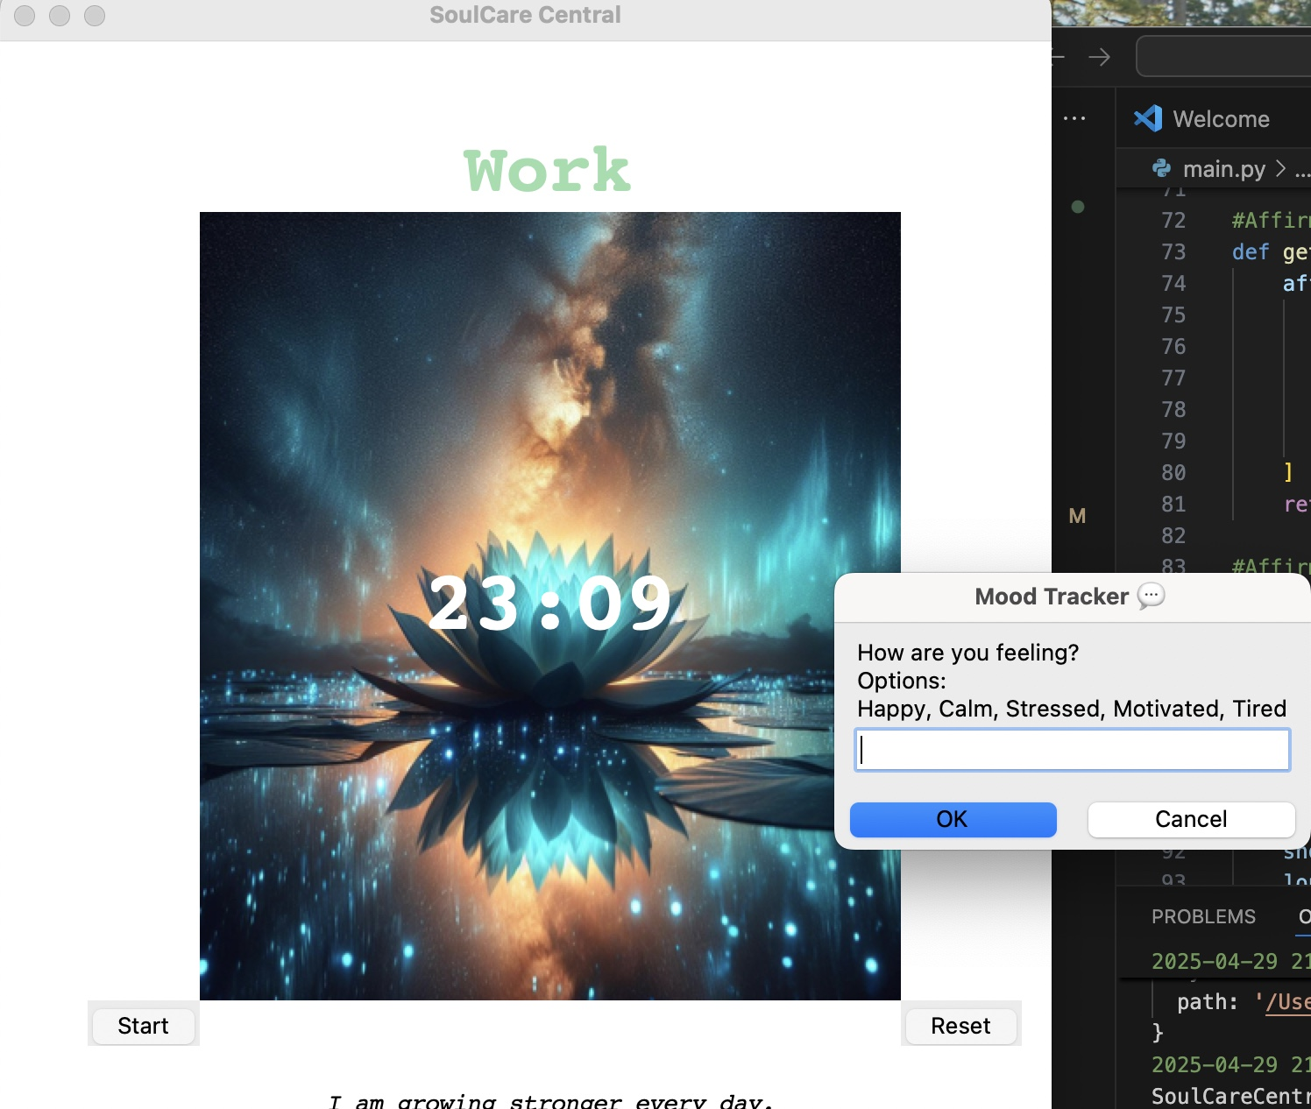
🪷
SoulCare Central
A digital wellness hub for self-care, mindfulness, and productivity. 🌿
👩🏽‍💻Project Team:
Shanancy Johnson

